Slide 1
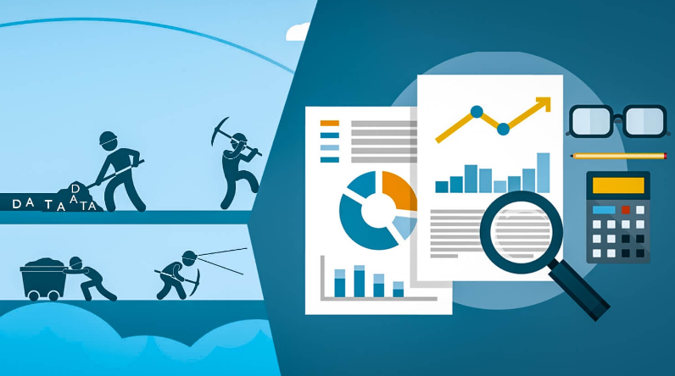
Data Mining
Predictive Analytics

Slide 2
Definition
Data Mining
Discovering new and useful patterns from large datasets through the application of advanced analytics
Predictive Analytics
Using new and useful patterns discovered in large datasets to predict future outcomes

Slide 3
Data Mining Process Cross-Industry Standard Process for Data Mining – CRISP-DM
Business Understanding
Data Understanding
Data Preparation
Model Building
Testing and Evaluation
Deployment

Slide 4
Predictive Analytics Process
Define
Define Business Goal
What data is needed to achieve the business goal?
Collect
Collect Additional Data
What is the reason behind the new pattern that was discovered using data mining techniques?
Predict
Draft Predictive Model
What predictions can be made from the model created with collected data and business knowledge?

Slide 5



Data Mining and Predictive Analytics Relationship
“Data mining is an enabling technology for predictive analytics” (Business Intelligence, Analytics, and Data Science, p. 215)
Data Mining | + | Business Knowledge | = | Predictive Analytics

Slide 6
Data Mining and Predictive Analytics Advantages
Boost sales
Develop customer insights
Increase operational efficiency
Improve decision making
Improve supply chain management
Transform risk management strategies

Slide 7



Data Mining and Predictive Analytics Potential Applications
Law Enforcement Discover crime patterns to help solve new cases | Healthcare Detect chronic and severe illness early to mitigate disease | Manufacturing Predict equipment failures before they occur to improve reliability

Slide 8
Big Tech E-Commerce Sales Analysis

Slide 9
Big Tech E-Commerce Sales Analysis

Slide 10
Big Tech E-Commerce Sales Analysis
Total 2022 Unit Sales = 7564

Slide 11
Big Tech E-Commerce Customer Behavior

Slide 12
Big Tech E-Commerce Customer Behavior
2022 Number of Orders Placed | 2500
2022 Average Order Value | $2,125

Slide 13
Market Basket Analysis (Association Rule Mining)
Top Selling Product = Computer
Lift = Actual Occurrences of Product Combination/Predicted Occurrences of Product Combination
Did customers that bought a computer buy any other product type in 2022 at a higher frequency than expected by chance?
2-Way Lift
Product #1 | Product #2 | Actual Occurances | Product #2 Frequency | Product #1 Frequency | Total Occurances | Predicted Occurances | Lift
Computer | Camera | 161 | 0.54 | 0.59 | 529.00 | 168.57 | 0.96
Computer | Headphones | 168 | 0.54 | 0.59 | 529.00 | 169.17 | 0.99
Computer | Laptop | 178 | 0.57 | 0.59 | 529.00 | 180.45 | 0.99
Computer | Mobile | 165 | 0.52 | 0.59 | 529.00 | 162.64 | 1.01
Computer | Tablet | 174 | 0.55 | 0.59 | 529.00 | 173.32 | 1.00
There is a slight positive relationship between computer purchase and mobile purchase. Placing a marketing advertisement for a mobile while a customer is purchasing a computer may be explored.
Notes:
Lift is a measure of the association strength between the two identified products in this market basket analysis.

Slide 14
Forecasted 2023 Total Product Sales
Month | Actual Sales | Trend Sales | Seasonal Factor
Jan 22 | 628 | 599.45 | 1.05
Feb 22 | 526 | 605.06 | 0.87
Mar 22 | 583 | 610.68 | 0.95
Apr 22 | 621 | 616.29 | 1.01
May 22 | 637 | 621.91 | 1.02
Jun 22 | 713 | 627.53 | 1.14
Jul 22 | 656 | 633.14 | 1.04
Aug 22 | 632 | 638.76 | 0.99
Sept 22 | 676 | 644.37 | 1.05
Oct 22 | 617 | 649.99 | 0.95
Nov 22 | 609 | 655.60 | 0.93
Dec 22 | 666 | 661.22 | 1.01

Slide 15
Forecasted 2023 Total Sales Revenue
Month | Actual Revenue | Trend Revenue | Seasonal Factor
Jan 22 | $ 410,450.00 | $ 404,657.05 | 1.01
Feb 22 | $ 332,150.00 | $ 411,574.71 | 0.81
Mar 22 | $ 401,200.00 | $ 418,492.37 | 0.96
Apr 22 | $ 455,000.00 | $ 425,410.02 | 1.07
May 22 | $ 456,000.00 | $ 432,327.68 | 1.05
Jun 22 | $ 528,850.00 | $ 439,245.34 | 1.20
Jul 22 | $ 477,000.00 | $ 446,163.00 | 1.07
Aug 22 | $ 403,900.00 | $ 453,080.65 | 0.89
Sept 22 | $ 474,800.00 | $ 459,998.31 | 1.03
Oct 22 | $ 438,600.00 | $ 466,915.97 | 0.94
Nov 22 | $ 474,700.00 | $ 473,833.62 | 1.00
Dec 22 | $ 459,800.00 | $ 480,751.28 | 0.96

